Slide 1

Welcome back!
Studio S12
Ma Chi Kin Brian
e1121386@u.nus.edu
Tele: @bmanara

Slide 2
Just 2 more weeks left…

Slide 3
Agenda for Today
Admin Matters
Recap
S12 Studio Worksheet
S12 In-class Studio Worksheet

Slide 4
Admin Matters
Practical Assessment
Date & Time: 9th November 2024, 1300hrs - 1440hrs (This Saturday)
Check your venue assignment once released!
Reach the venue early! So that you won’t be rushing to turn on your laptop etc.
Ensure that laptops are fully charged. (Bring charger along just in case)
Open Book, but there are caveats to this.
Check canvas for the full set of guidelines/rules.
Don’t try to cheat… it might be tempting to do so especially since it is held in a Lecture Theatre, but it ain’t worth it.
Practice using the Past Year Assessments given in Source Academy!

Slide 5
RECAP
Metacircular Evaluator
CSE Machine in Source
Notes:
*Quick runthrough, main focus for this studio is Streams…

Slide 6
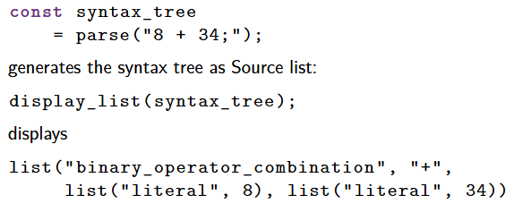
Metacircular Evaluator (Recap)
Support for Parsing in Source 4
Generates Syntax Tree

Slide 7
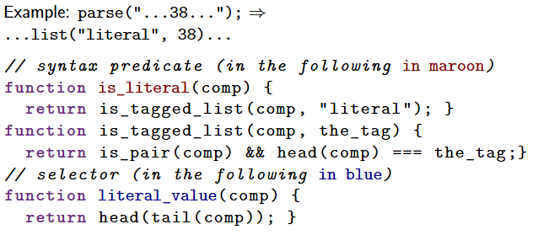
Metacircular Evaluator (Recap)
Syntax Predicates and Selectors

Slide 8
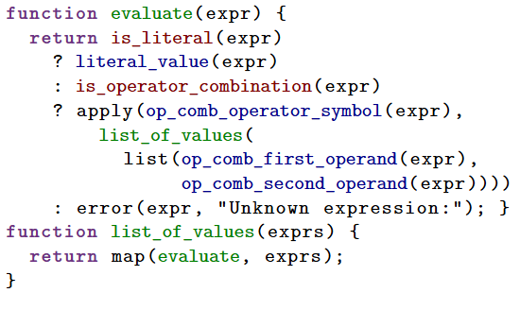
Metacircular Evaluator (Recap)
Calculator Language

Slide 9
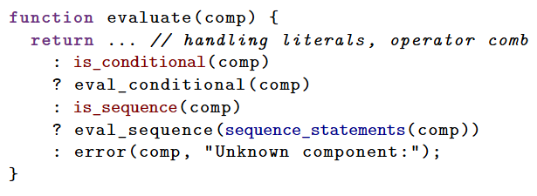
Metacircular Evaluator (Recap)
Adding booleans, conditionals and sequences

Slide 10
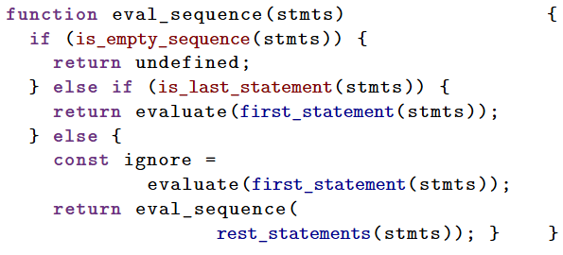
Metacircular Evaluator (Recap)
Evaluating Sequences
Notes:
Sequence of statements must be evaluated correctly…

Slide 11
Metacircular Evaluator (Recap)
Evaluating Sequences
Notes:
Sequence of statements must be evaluated correctly…
Example of a sequence: 8 + 34; true ? 1 + 2 : 17;

Slide 12
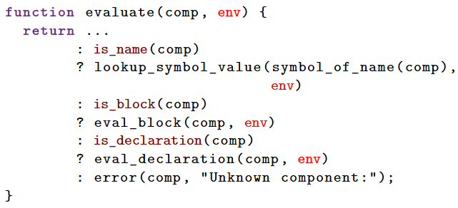
Metacircular Evaluator
Adding blocks and declarations
Notes:
Now, we need to keep track of the environment we want to evaluate in…

Slide 13
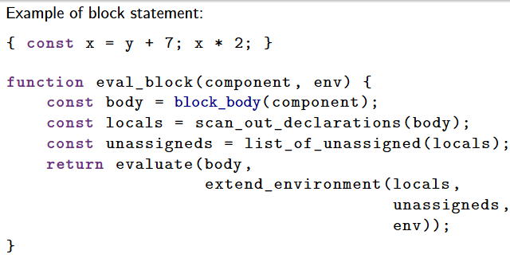
Metacircular Evaluator
Evaluating Blocks
Notes:
Now, we need to keep track of the environment we want to evaluate in…

Slide 14
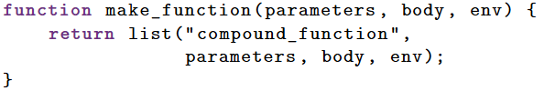
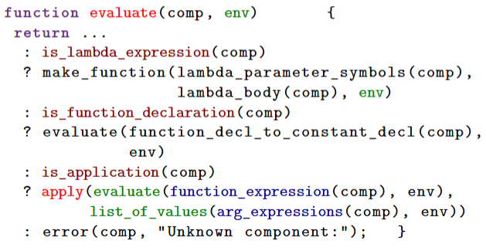
Metacircular Evaluator
Adding compound functions (no return)
Notes:
New make_function and of course, with functions, we need to deal with function application

Slide 15
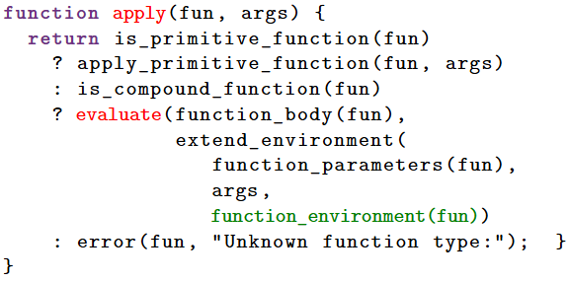
Metacircular Evaluator
Function Application
Notes:
New make_function and of course, with functions, we need to deal with function application

Slide 16
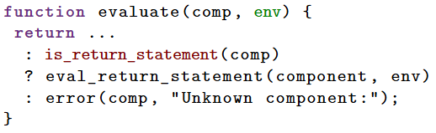
Metacircular Evaluator
Compound Function
Functions that do not evaluate a return statement must still return undefined
Evaluation of a return statement anywhere in the function body returns from the function with the result of evaluating the return expression
Notes:
Now, we need to handle return statements…

Slide 17
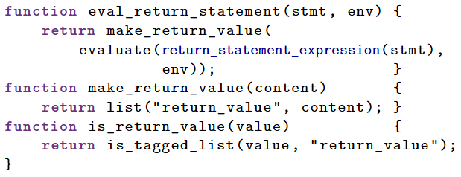
Metacircular Evaluator
Handling return statements
Notes:
Example: return n * fact(n - 1);
It is a return statement, so we call eval_return_statement, then gets the result of the evaluation of the return statement expression.

Slide 18
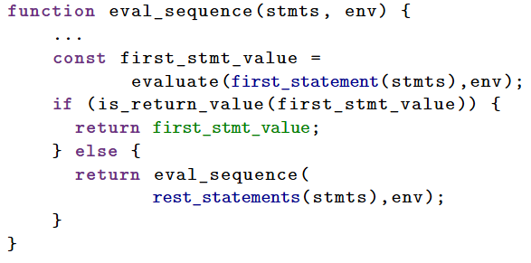
Metacircular Evaluator
Handling return values in sequences
Notes:
Evaluating sequence. If there is a return statement, return it, else continue evaluating the sequence!

Slide 19
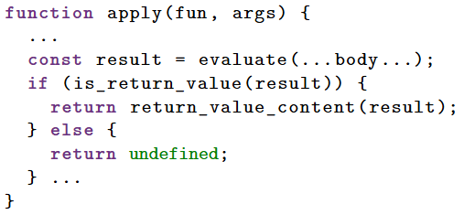
Metacircular Evaluator
Handling return values in apply
Notes:
Handling the case where there might be no return statement. Return undefined if such

Slide 20
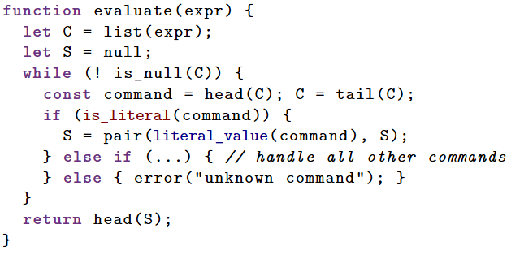
CSE Machine
Structure of CS Machine for Calculator Language (Evaluating Literals)
Notes:
Source Academy Playground
Link is to show how it evaluates literal expressions.

Slide 21
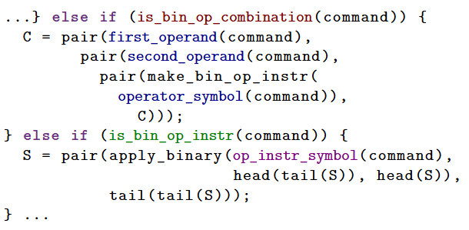
CSE Machine
Structure of CS Machine for Calculator Language (Evaluating Operator Combinations)
Notes:
Source Academy Playground
Link is to show how it evaluates literal expressions and operator combinations.
Recall: apply_binary

Slide 22
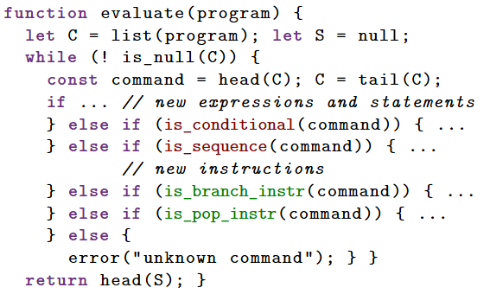
CSE Machine
Structure of CS Machine (Booleans, Conditionals & Sequences)
Notes:
https://share.sourceacademy.nus.edu.sg/waluigi1
Link to how it deals with the above…

Slide 23
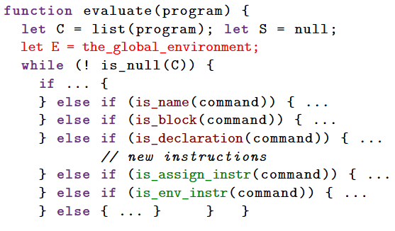
CSE Machine
Structure of CSE Machine (Blocks & Conditionals)
Notes:
https://share.sourceacademy.nus.edu.sg/waluigi2
Link to how it deals with the above…

Slide 24
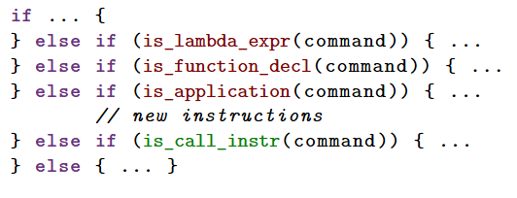
CSE Machine
Structure of CSE Machine (Simple Compound Functions)
Notes:
https://share.sourceacademy.nus.edu.sg/waluigi3
Link to how it deals with the above…

Slide 25
CSE Machine
There are many more things we need to handle in the CSE Machine still…
Handling missing return (returns undefined)
Complex function objects (multiple return statements)
Evaluating while loops (is_while_loop)
Evaluating for loops
Evaluating array expressions (is_array_expression)
Evaluating array instructions (is_array_instruction)
Array access + inst
Array assignment + inst
All the above and its CSE Machine structure can be found in the Lecture Slides!

Slide 26
Value Producing
Value of Statements
Declarations are not value-producing
Blocks are value producing if at least one statement in the body sequence is value-producing
All other kinds of statements are value-producing
Value of a given sequence is the value of its last value-producing statement

Slide 27
Summary
Communicating computational processes using programs
CSE Machine as a “while loop”
Instructions on control let uss implement complex operations, using the stash for intermediate results.

Slide 28
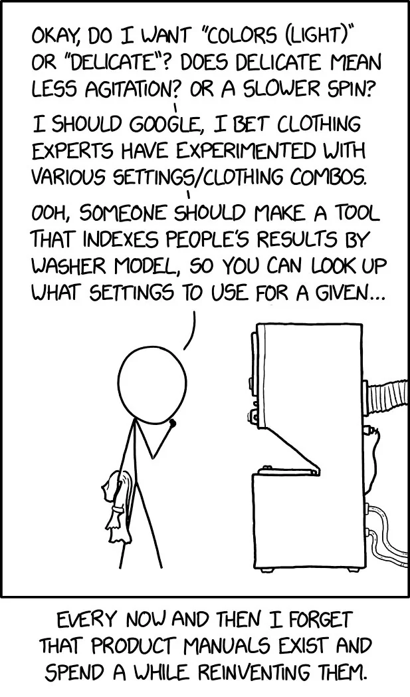
CSE Machine?
S12 Studio Sheet & In-class
Notes:
https://share.sourceacademy.nus.edu.sg/waluigi4
https://share.sourceacademy.nus.edu.sg/waluigi5
https://share.sourceacademy.nus.edu.sg/waluigi6ans
https://share.sourceacademy.nus.edu.sg/waluigi7ans

Slide 29
See you next week!
Good Luck for Practical Assessment!

